Slide 1
An Overview of
Machine Learning

Slide 2
What is machine learning?
A branch of artificial intelligence, concerned with the design and development of algorithms that allow computers to evolve behaviors based on empirical data.
As intelligence requires knowledge, it is necessary for the computers to acquire knowledge.

Slide 3
Machine Learning
• Herbert Alexander Simon:
“Learning is any process by which a system improves performance from experience.”
“Machine Learning is concerned with computer programs that automatically improve their
performance through experience. “

Slide 4
Contd…
Machine Learning
Study of algorithms that improve their performance
  at some task with experience
Optimize a performance criterion using example data or past experience.
Role of Statistics: Inference from a sample
Role of Computer science: Efficient algorithms to
  Solve the optimization problem
  Representing and evaluating the model for inference

Slide 5
Why Machine Learning?
• Develop systems that can automatically adapt and customize
themselves to individual users.
– Personalized news or mail filter
• Discover new knowledge from large databases (data mining).
– Market basket analysis (e.g. diapers and beer)
• Ability to mimic human and replace certain monotonous tasks -
which require some intelligence.
• like recognizing handwritten characters
• Develop systems that are too difficult/expensive to construct
manually because they require specific detailed skills or knowledge tuned to a specific task (knowledge engineering bottleneck).

Slide 6
Why Machine Learning?
Learning to Filter Spam
Example: Spam Filtering
Spam - is all email the user does not want to receive and has not asked to receive
T: Identify Spam Emails
P: % of spam emails that were filtered
% of ham/ (non-spam) emails that were incorrectly filtered-out
E: a database of emails that were labelled by users

Slide 7
Growth of Machine Learning
Machine learning is preferred approach to
  Speech recognition, Natural language processing
  Computer vision
  Medical outcomes analysis
  Robot control
  Computational biology
This trend is accelerating
  Improved machine learning algorithms
  Improved data capture, networking, faster computers
  Software too complex to write by hand
  New sensors / IO devices
  Demand for self-customization to user, environment
  It turns out to be difficult to extract knowledge from human experts→ failure of expert systems in the 1980’s.

Slide 8
Learning system model
Testing
Input Samples
Learning Method
System
Training

Slide 9
Training and testing
Data acquisition
Practical usage
Universal set
(unobserved)
Training set (observed)
Testing set
(unobserved)

Slide 10
Training and testing
Training is the process of making the system able to learn.
No free lunch rule:
  Training set and testing set come from the same distribution
  Need to make some assumptions or bias

Slide 11
Performance
There are several factors affecting the performance:
  Types of training provided.
  The form and extent of any initial background knowledge.
  The type of feedback provided.
  The learning algorithms used.
Two important factors:
  Modeling
  Optimization

Slide 12
Algorithms
The success of machine learning system also depends on the algorithms.
The algorithms control the search to find and build the knowledge structures.
The learning algorithms should extract useful information from training examples.

Slide 13


Algorithms
Supervised learning ( )
  Prediction
  Classification (discrete labels), Regression (real values)
Unsupervised learning ( )
  Clustering
  Probability distribution estimation
  Finding association (in features)
  Dimension reduction
Semi-supervised learning
Reinforcement learning
  Decision making (robot, chess machine)

Slide 14
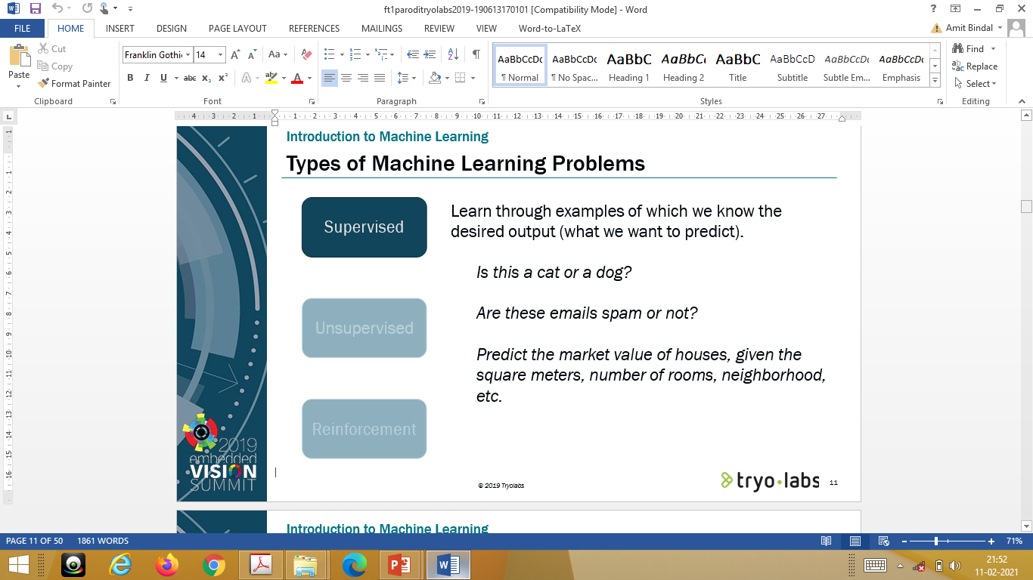

Slide 15
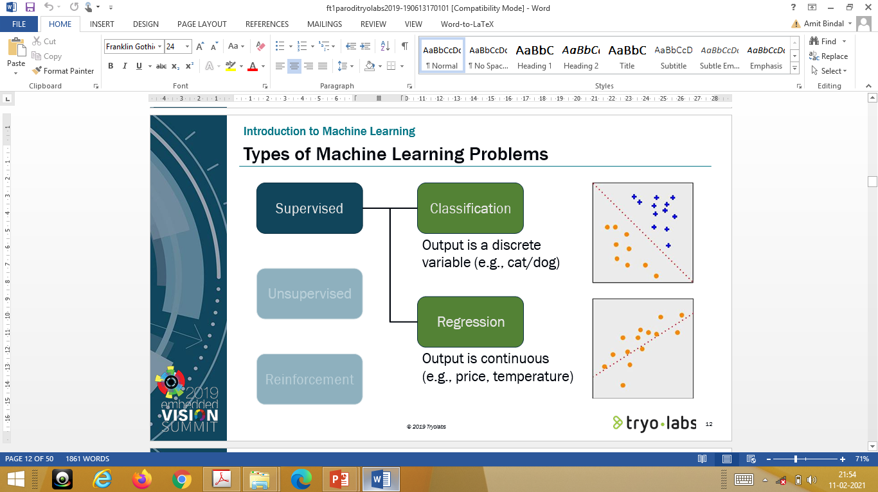

Slide 16
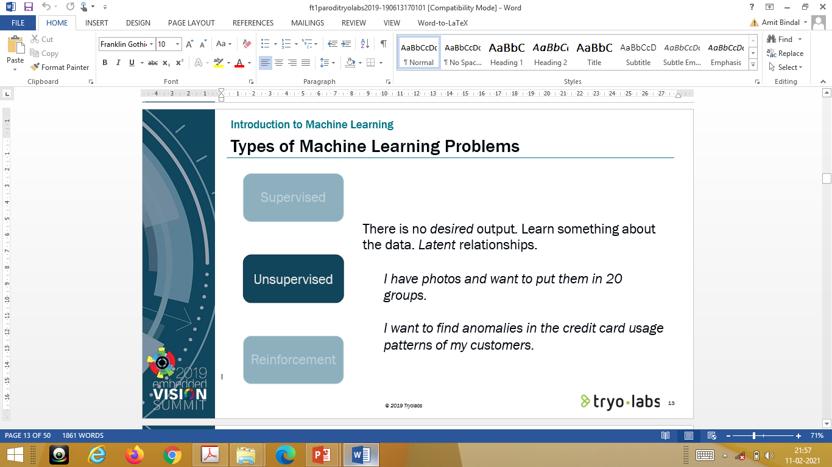

Slide 17
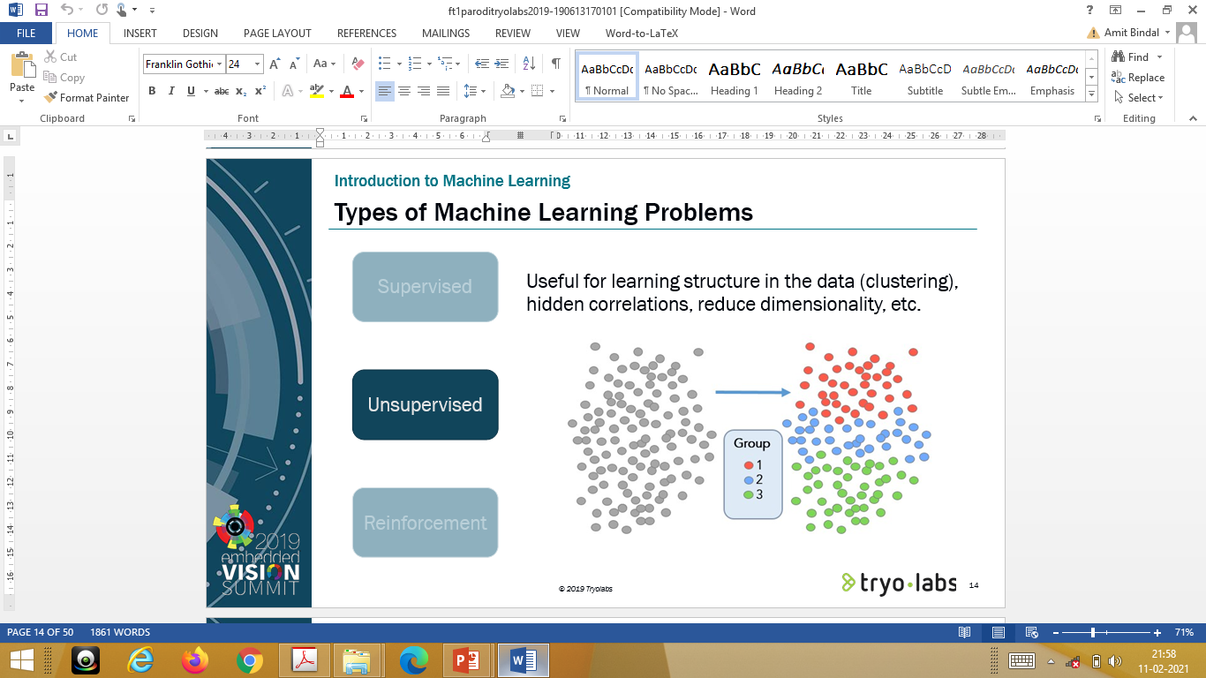

Slide 18


Slide 19
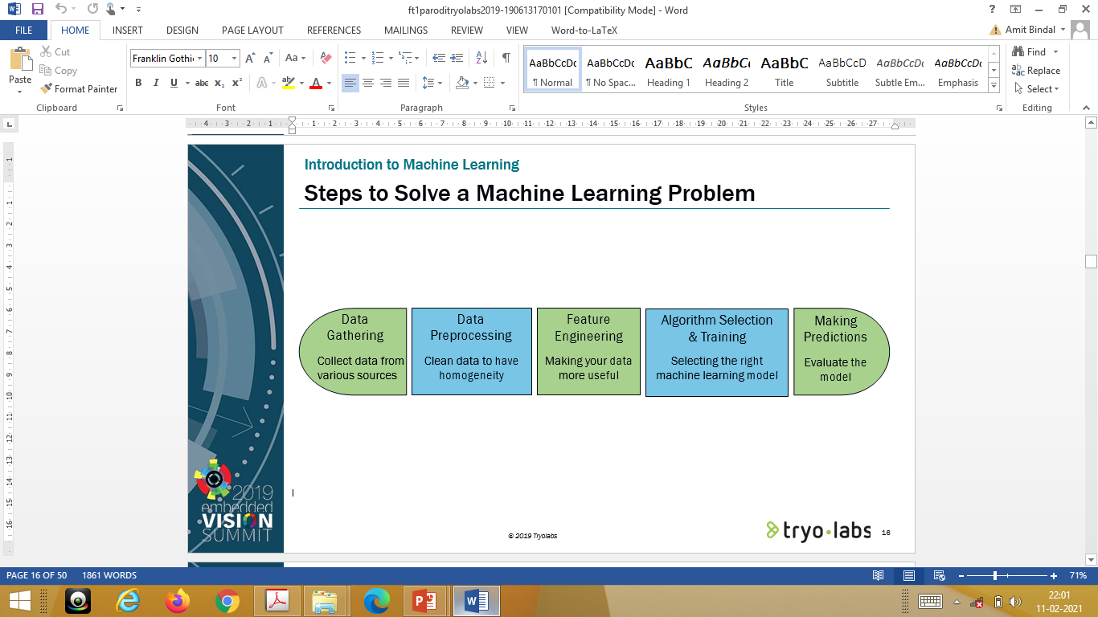

Slide 20
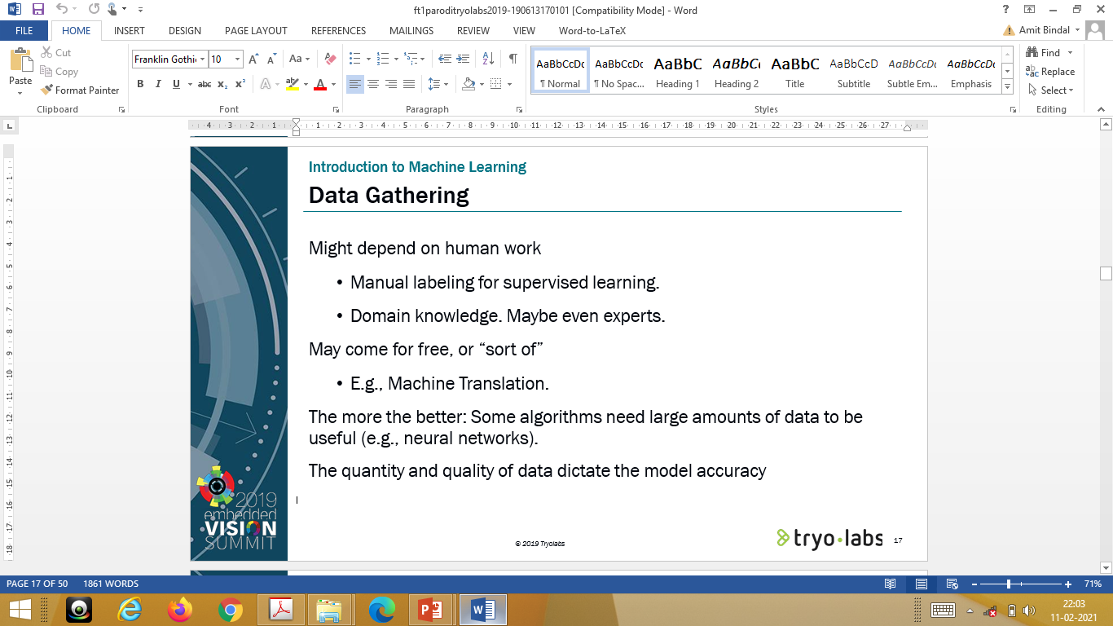

Slide 21
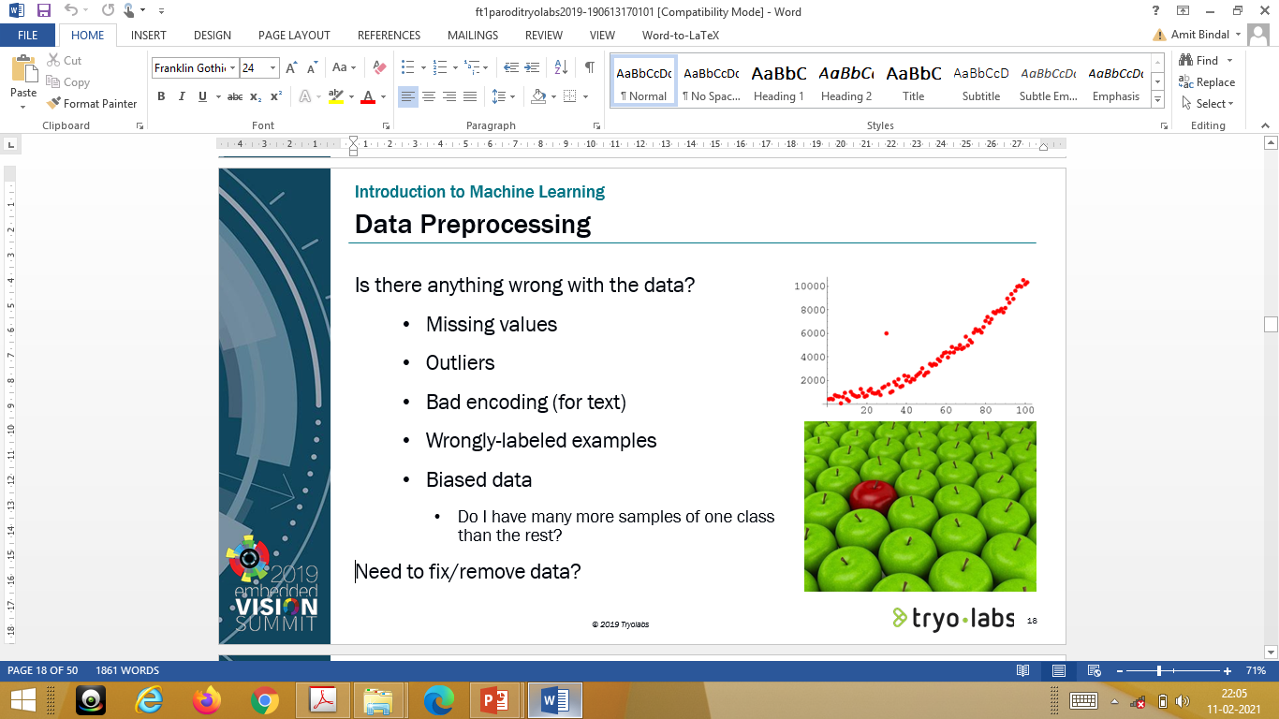

Slide 22
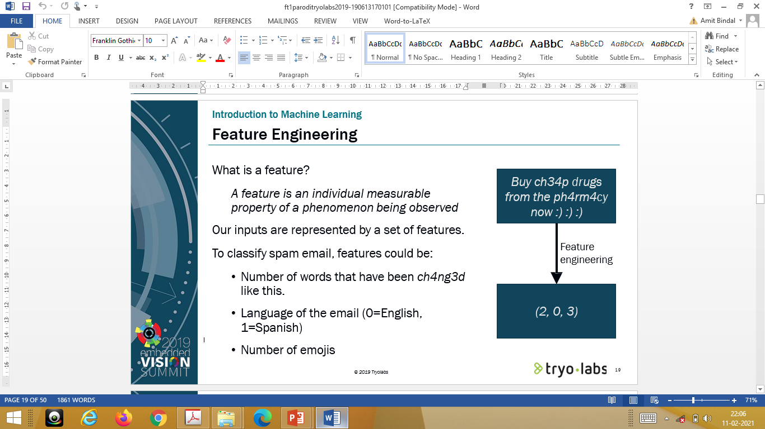

Slide 23
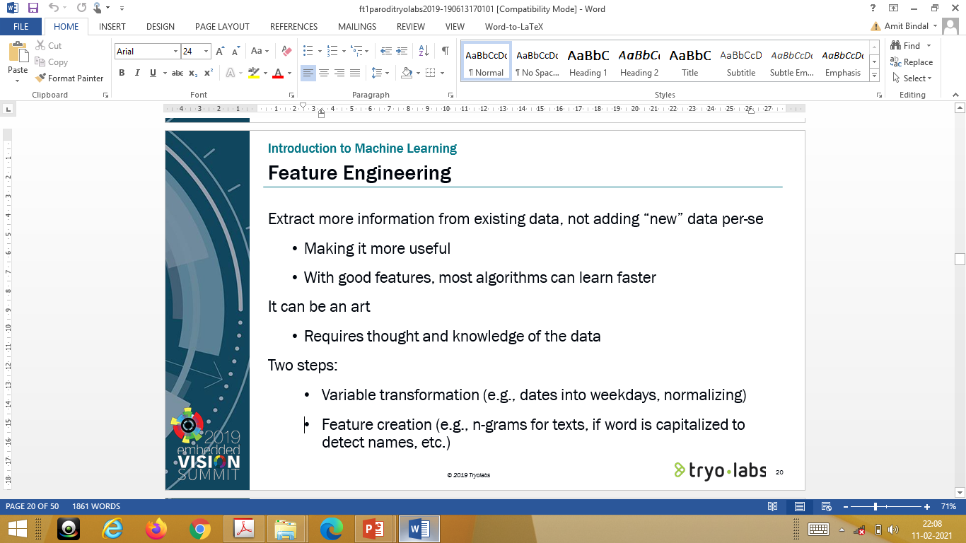

Slide 24
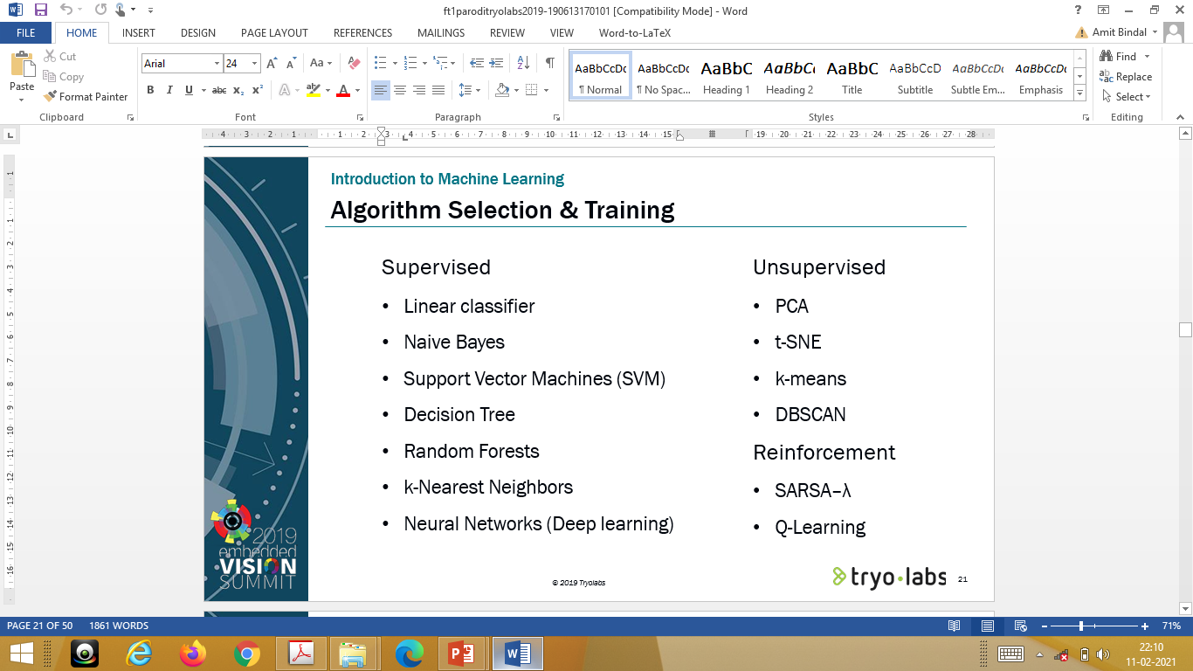

Slide 25
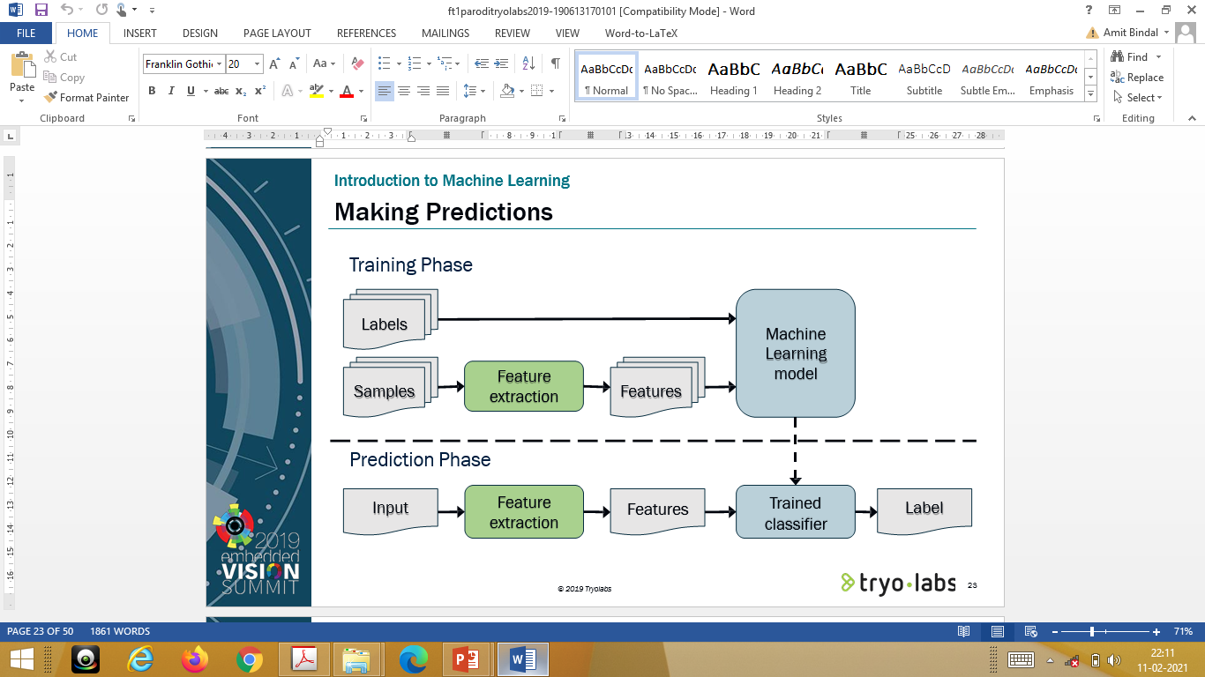

Slide 26
Algorithms
Supervised learning
Unsupervised learning
Semi-supervised learning

Slide 27
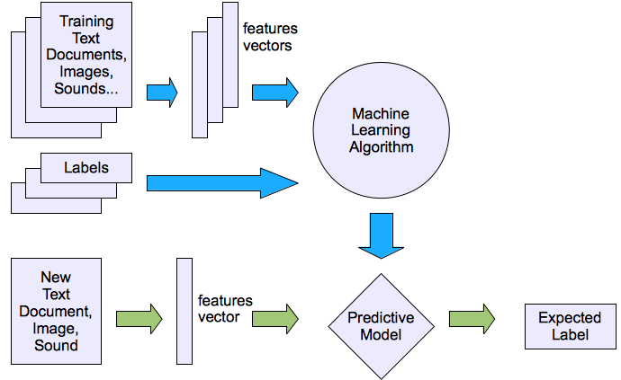
Machine learning structure
Supervised learning

Slide 28
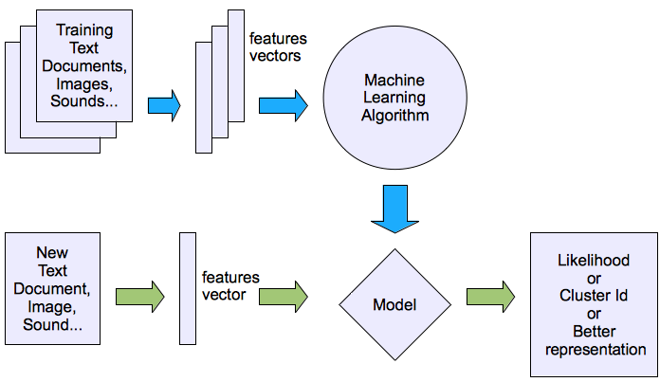
Machine learning structure
Unsupervised learning

Slide 29
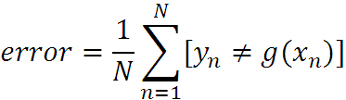
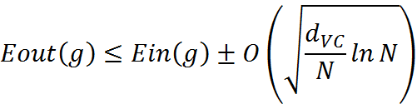
What are we seeking?
Supervised: Low E-out or maximize probabilistic terms
Unsupervised: Minimum quantization error, Minimum distance, MAP, MLE(maximum likelihood estimation)
E-in: for training set
E-out: for testing set

Slide 30




What are we seeking?
Under-fitting VS. Over-fitting (fixed N)
error
(model = hypothesis + loss functions)

Slide 31
Learning techniques
Supervised learning categories and techniques
  Linear classifier (numerical functions)
  Parametric (Probabilistic functions)
    Naïve Bayes, Gaussian discriminant analysis (GDA), Hidden Markov models (HMM), Probabilistic graphical models
  Non-parametric (Instance-based functions)
    K-nearest neighbors, Kernel regression, Kernel density estimation, Local regression
  Non-metric (Symbolic functions)
    Classification and regression tree (CART), decision tree
  Aggregation
    Bagging (bootstrap + aggregation), Adaboost, Random forest

Slide 32

Learning techniques
Linear classifier
Techniques:
  Perceptron
  Logistic regression
  Support vector machine (SVM)
  Ada-line
  Multi-layer perceptron (MLP)
, where w is an d-dim vector (learned)

Slide 33
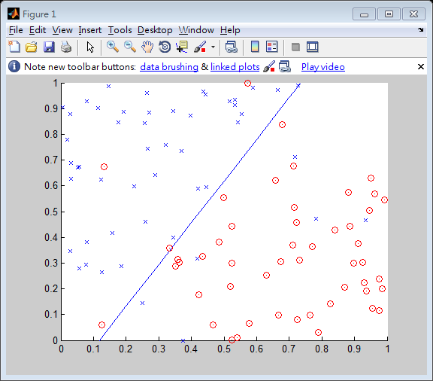
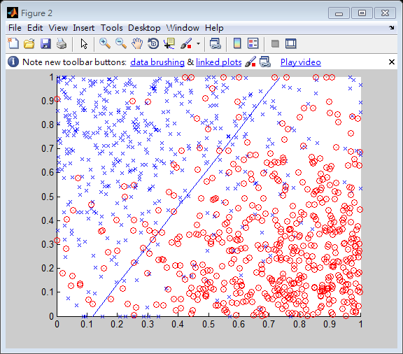
Learning techniques
Using perceptron learning algorithm(PLA)
Training
Testing
Error rate: 0.10
Error rate: 0.156

Slide 34
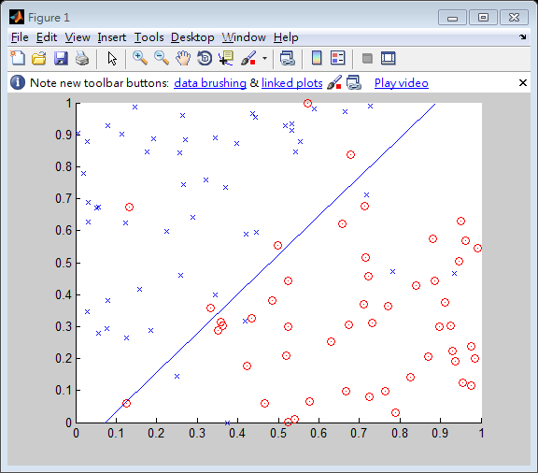
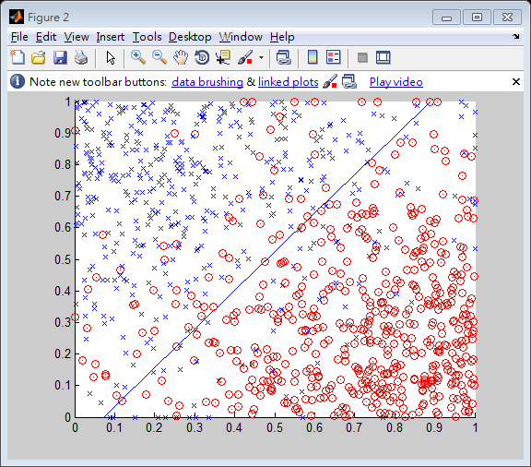
Learning techniques
Using logistic regression
Training
Testing
Error rate: 0.11
Error rate: 0.145

Slide 35



Learning techniques
Non-linear case
Support vector machine (SVM):
  Linear to nonlinear: Feature transform and kernel function

Slide 36
Learning techniques
Unsupervised learning categories and techniques
  Clustering
    K-means clustering
    Spectral clustering
  Density Estimation
    Gaussian mixture model (GMM)
    Graphical models
  Dimensionality reduction
    Principal component analysis (PCA)
    Factor analysis

Slide 37
Applications
Face detection
Object detection and recognition
Image segmentation
Multimedia event detection
Economical and commercial usage

